Slide 1
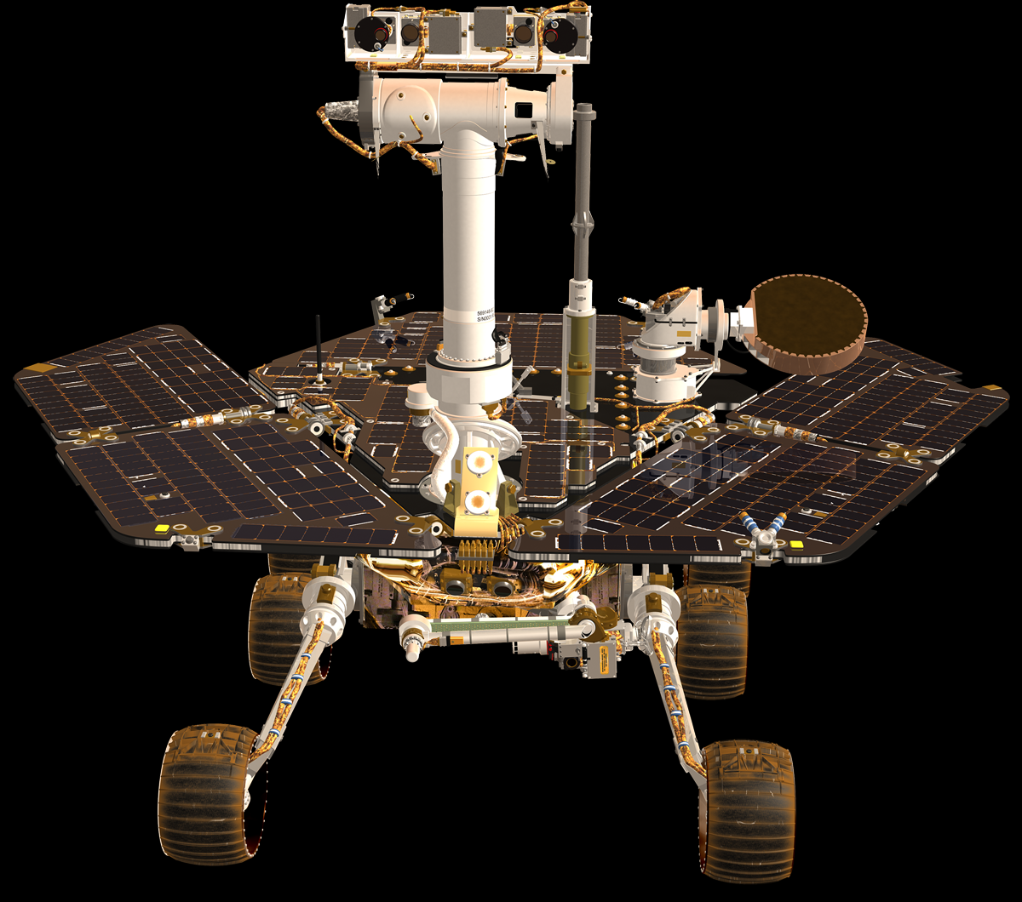
Mars Rover
Robotic Hardware System
Name: Mohamad Luqman Idlan bin Mohamad Azahari
Matric: 1723539

Slide 2
Main components
1. Design
2. Navigation and control system
3. Propulsion system
4. Data Collection
5. Data Transmission
6. Power Management

Slide 3
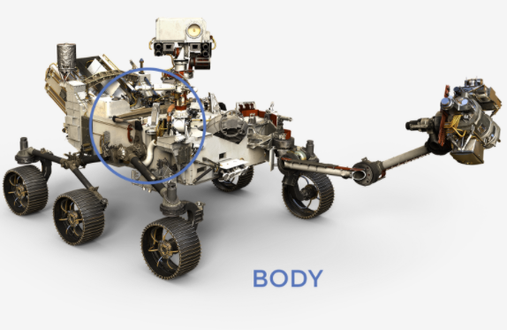
Design

Slide 4
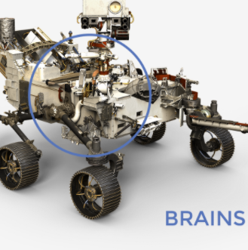
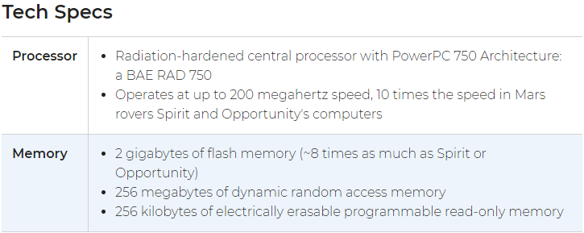
Navigation and control system
The Mars Rover brain is called the Rover Compute Element (RCE)
It interfaces with the engineering functions of the Perseverance rover over two networks which follow an aerospace industry standard designed especially for the high-reliability requirements of airplanes and spacecraft.

Slide 5
Navigation and control system
The computer contains special memory to tolerate the extreme radiation environment that exists in space and on the Martian surface.
The Perseverance rover carries an Inertial Measurement Unit (IMU) which is used in rover navigation to support safe traverses and to estimate the degree of tilt the rover is experiencing on the surface of Mars.
The rover monitor its health by registering signs of health such as temperature and power levels.
Activities such as taking pictures, driving, and operating the instruments are performed under commands transmitted in a command sequence to the rover from the flight team back on Earth.
The rover has two "computer brains," one of which is normally asleep. In case of problems the other computer brain can be awakened to take over control and continue the mission.

Slide 6
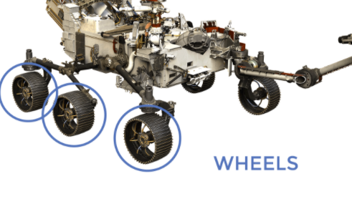
Propulsion system
The Perseverance rover has six wheels, each with its own individual motor.
The two front and two rear wheels also have individual steering motors.
This steering capability allows the vehicle to turn in place, a full 360 degrees.
The four-wheel steering also allows the rover to swerve and curve, making arcing turns.

Slide 7
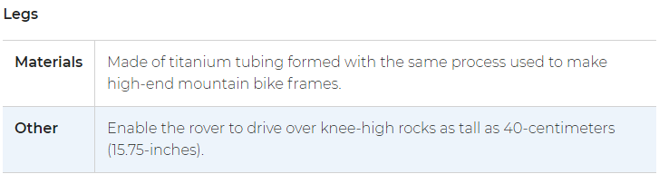
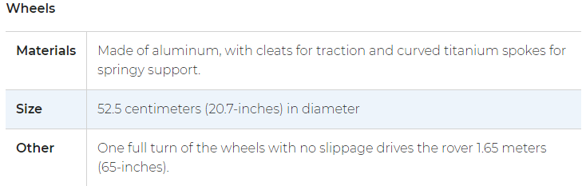
Propulsion system (Tech Specs)

Slide 8
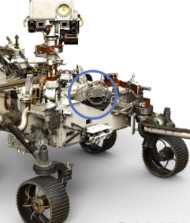
Data Collection (Sample Handling)
It gathers rocks and soil using its drill. Then it stores the samples in tubes on the Martian surface. The whole process is called “sample caching”
It potentially be able to return the samples to Earth
There are three steps for sample handling

Slide 9
Step 1: Collecting the samples
It carefully pick rock and soil. The samples are sealed in tubes and left in a well-identified place.
The rover belly is equiped with equipment and supplies to collect samples such as drill carousel.
The belly contain small arm that acts as a lab assistant to the big arm.
Witness tube is to make sure the samples collected are only from Martian surface, not contiminated from Earth biological materials.

Slide 10
Step 2: Storing Onboard
After collection, the sample tube is transferred back to the rover belly.
The small robotic arm will move the samples to inspection and sealing stations.
After the tubes are sealed, nothing can come in or out .
The tubes are stored in the rover belly until they are decided to drop off on the surface

Slide 11
Step 3: Depositing the samples on the surface
At a time and place of the team’s choosing, the samples are deposited on the surface called “sample cache depot”.
The place must be well documented by local landmarks and precise coordinates from orbital measurement.
The samples are available for pickup and potential return to Earth.

Slide 12
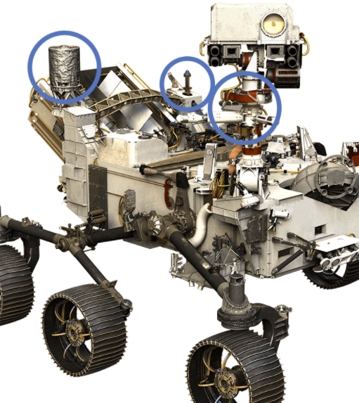
Data Transmission and communication
1. Ultra-High Frequency Antenna
2. X-band High-Gain Antenna
3. X-band Low-Gain Antenna
These antennas serve as “ears” and “voice” for the Rover. It also provides operational flexibility and back-up options just in case they are needed

Slide 13
Ultra-High Frequency Antenna
Ultra high frequency (UHF) antenna is to communicate from NASA’s orbiter around Mars to Earth.
It takes around 5 to 20 minutes for the radio signal to travel from Mars to Earth.
Data transmission rates at 2 Mb/s

Slide 14
The X-Band High-Gain Antenna
High gain allows the rover to focus its beam, allowing higher data rates transfer.
Radio frequency of 7 to 8 gigahertz
Transmitting data directly to and from Earth

Slide 15
The X-Band Low-Gain Antenna
Low gain is to receive signals.
Can send and receive information from omni-directions
Transmit low data rate to Deep Space Network antennas on Earth
Robust way to communicate with the rover.
Radio frequency of 7 to 8 gigahertz

Slide 16
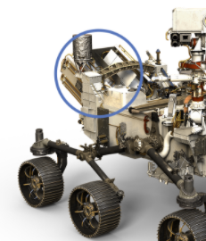
Power management
The Perseverance carries a radioisotope power system.
It produces electricity using the heat of plutonium’s radioactive decay
Power source is called “Multi-Mission Radioisotope Thermoelectric Generator”
The heat from the power source is used to keep the temperature at operating system.
It can last for 14 years for the duration of 3 Earth years rover mission

